Slide 1

ANNAMACHARYA INSTITUTE OF TECHNOLOGY AND SCIENCES::TIRUPATI Department of Computer Science and Engineering (Approved by AICTE, New Delhi & Permanent Affiliation to JNTUA, Anantapuramu.) Accredited by NBA, Accredited by NAAC with ‘A’ grade, Accredited by Institution of Engineers (India). A-grade awarded by AP Knowledge Mission. Recognized under sections 2(f) & 12(B) of UGC Act 1956. Venkatapuram (V), Karakambadi Road, Renigunta (M), Tirupati, Andhra Pradesh 517520.
A
Project on
SMART COLEGE MANAGEMENT SYSTEM
Submitted by
G.NANDA KISHORE REDDY [15AK1A0542]
R.LAKSHMI KIRAN [15AK1A0536]
V.HARI KRISHNA [15AK1A0524]
K.NAVEEN KUMAR [15AK1A0544]
GUIDE: HEAD OF THE DEPARTMENT:
K.RAJA SEKHAR,M.Tech. B.Rupa Devi, M.Tech,(P.hD),
Assistant Professor, Assistant Professor,
Department of CSE, Department of CSE,
AITS. AITS.

Slide 2
CONTENTS
ABSTRACT
Existing System
Problems on Existing System
Proposed System
Advantages of proposed System
System and Software Requirements.
System Architecture
UML Diagrams
DFD Diagrams
Implementation and Testing
Output Screens
Conclusion
Future Enhancememts

Slide 3
ABSTRACT
"Smart College Management System" manages the college Information like Student attendance, time tables, circulars, internal mark details and library management and also optional features like peer Live Bus tracking, Downloadable lecture notes.

Slide 4
Existing System
Faculty still collecting the attendance manually. Displaying marks, circulars, timetables are distributing manually.
Availability of books in the library must be checked by students in person.

Slide 5
Problems in Existing System
Catastrophic Data loss might occur.
Circulars might not be received by everyone.
Requires more Human efforts for data entry and also Error Prone.

Slide 6
Proposed System
Data collection is automated by using the android application and the data will get stored in the cloud database.
The data can be displayed through an Interactive android application.

Slide 7
Advantages in the Proposed System
Attendance Data management
Library Data management
Internal Marks data management
Publishing of Digital Circulars
Live BUS tracking
College Info display
Queries & Grievances portal
Hostel Registration

Slide 8
System & S/W Requirements
Operating System windows 10 / 7
RAM 8Gb / 4Gb
Processor intel core i3 or higher
Hard-Disk At least 240Gb
Software Requirements:
Android Studio
Database Used:
Firebase (Cloud database by Google).

Slide 9
Project Modules
There are two modules present in this project.
1.Student Module
2.Admin Module

Slide 10
Student Module Consists of Services like:
Viewing Attendance
Viewing Internal Marks
Viewing Circulars and Time Tables
Knowing Available Books in the library
Live Bus Tracking

Slide 11
Admin Module Consists of Services like:
Uploading of internal marks
Uploading Circulars and Time Tables
Taking Attendance in the application
Uploading Library Information

Slide 12
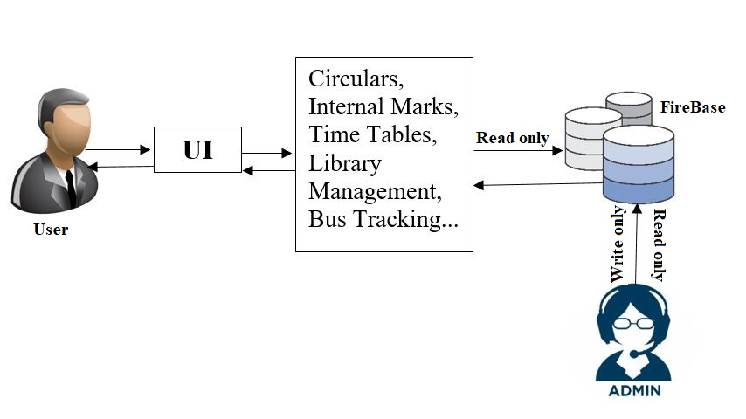
SYSTEM ARCHITECTURE

Slide 13
UML DIAGRAMS

Slide 14
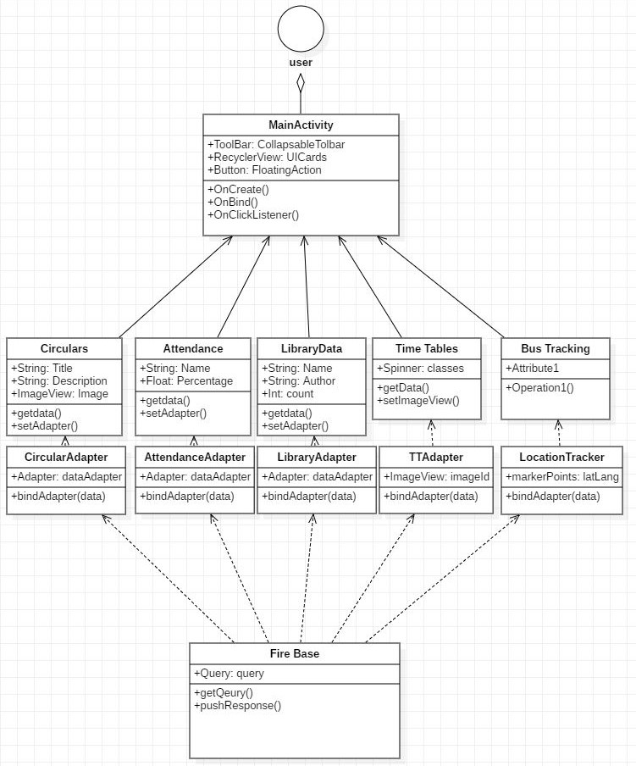
CLASS DIAGRAM FOR USER

Slide 15
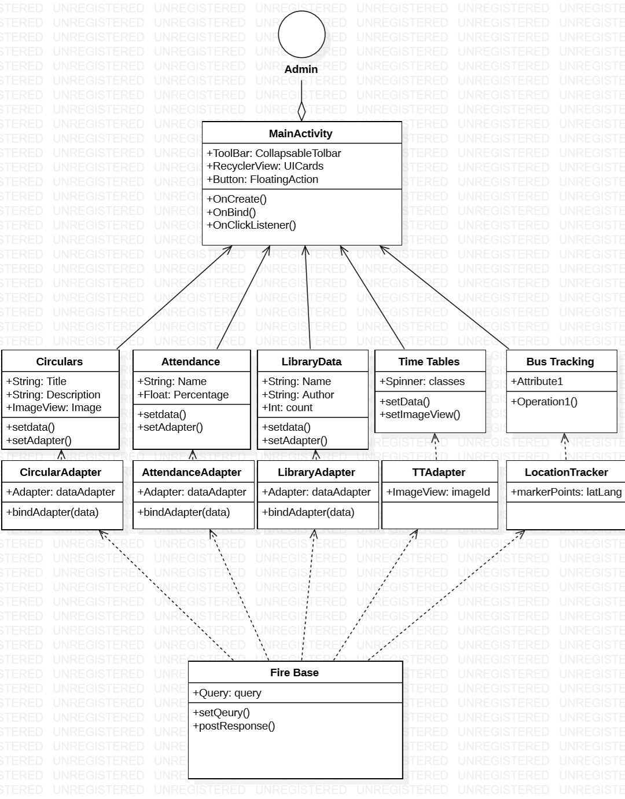
CLASS DIAGRAM FOR ADMIN

Slide 16
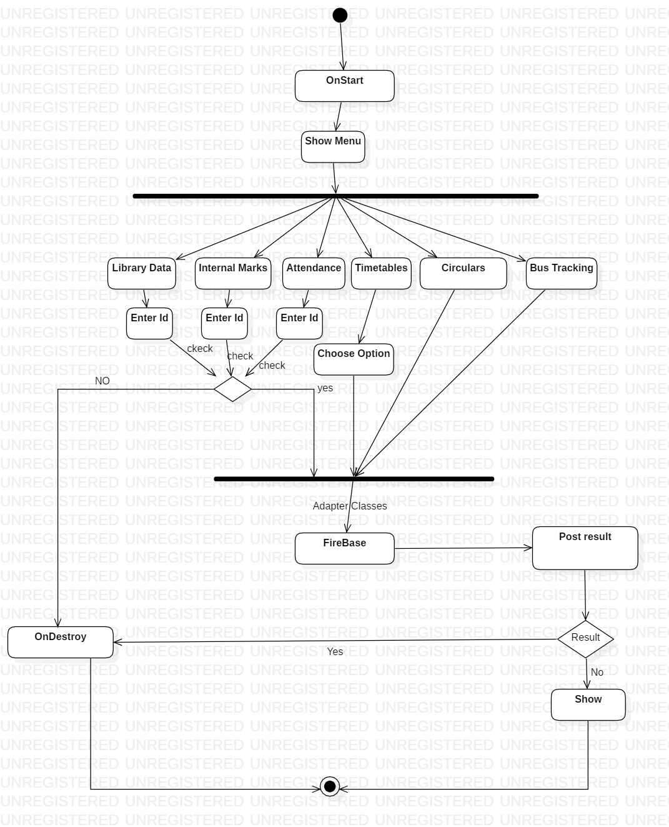
ACTIVITY DIAGRAM FOR USER

Slide 17
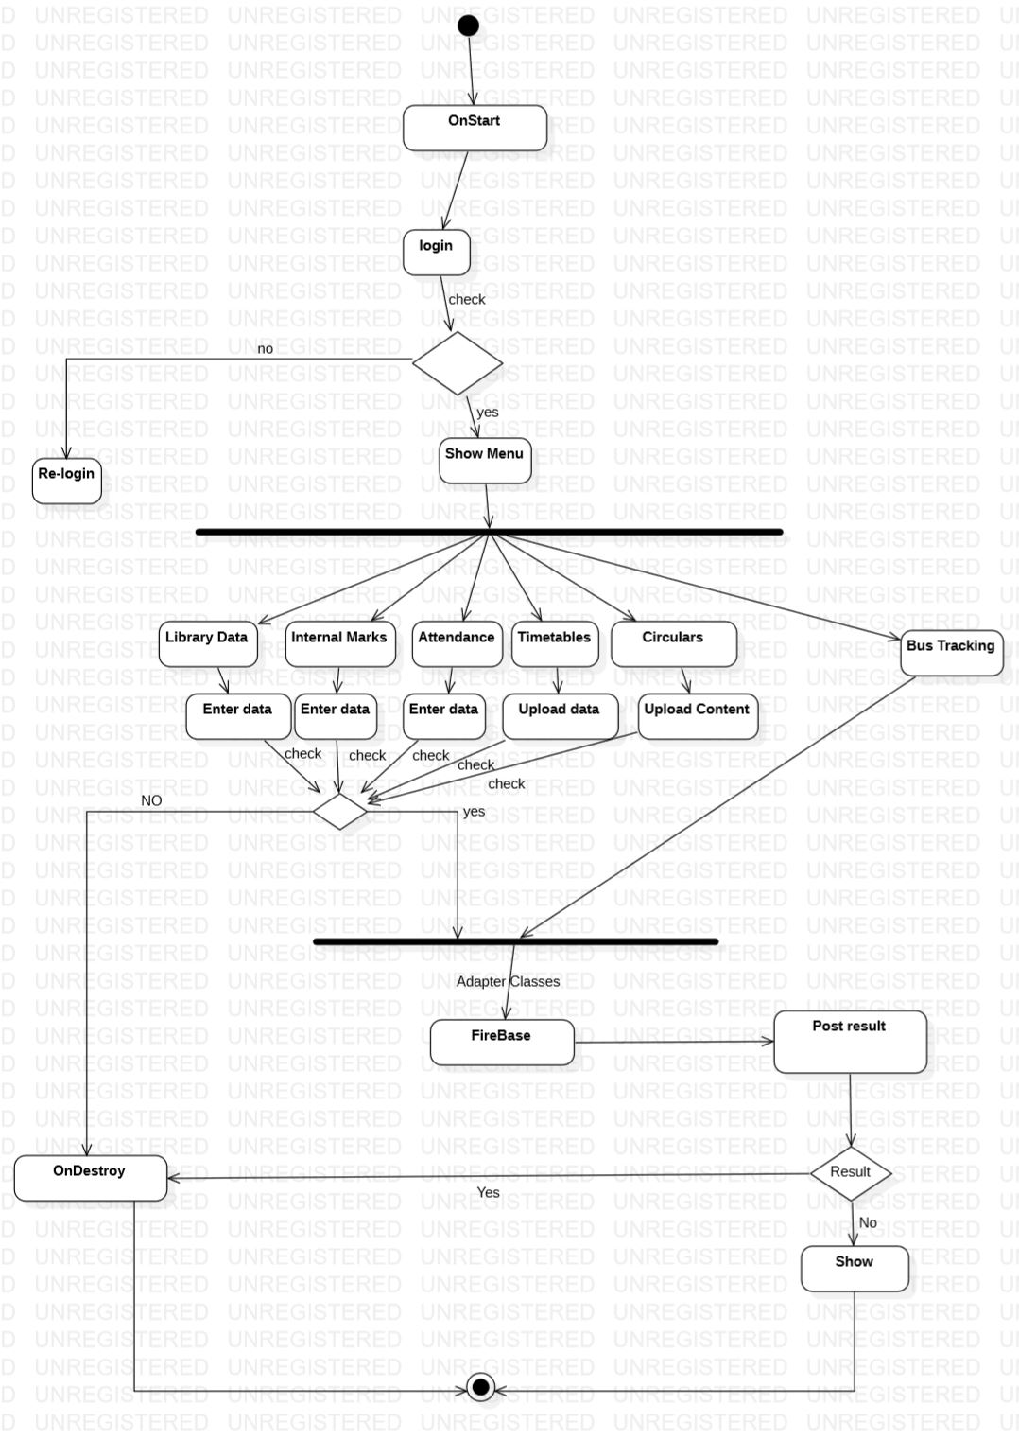
ACTIVITY DIAGRAM FOR ADMIN

Slide 18
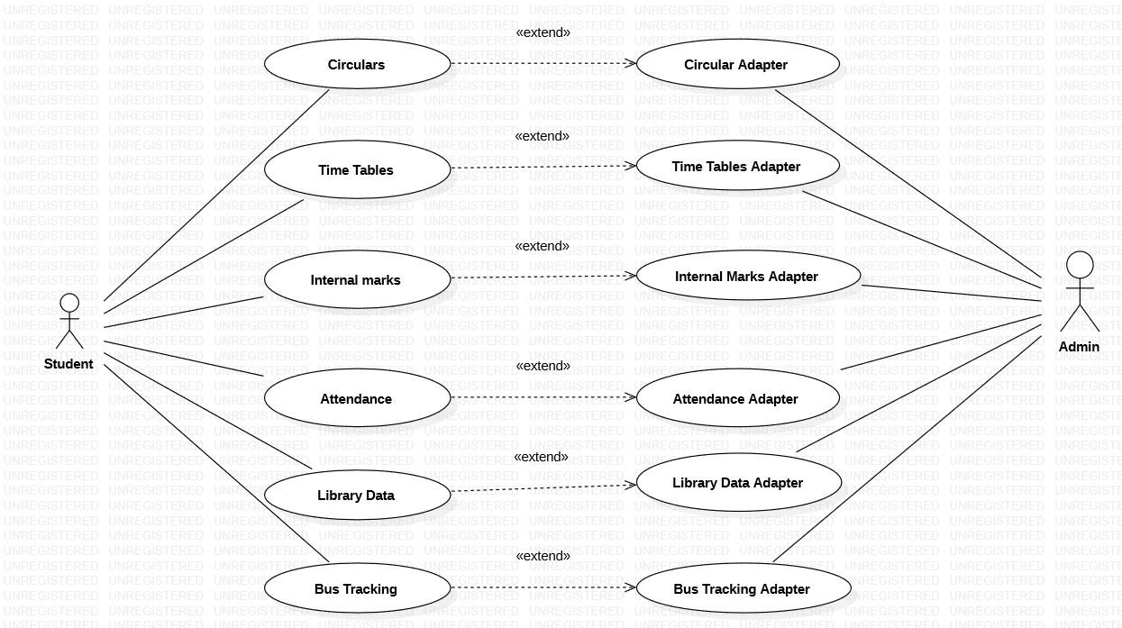
USECASE DIAGRAM

Slide 19
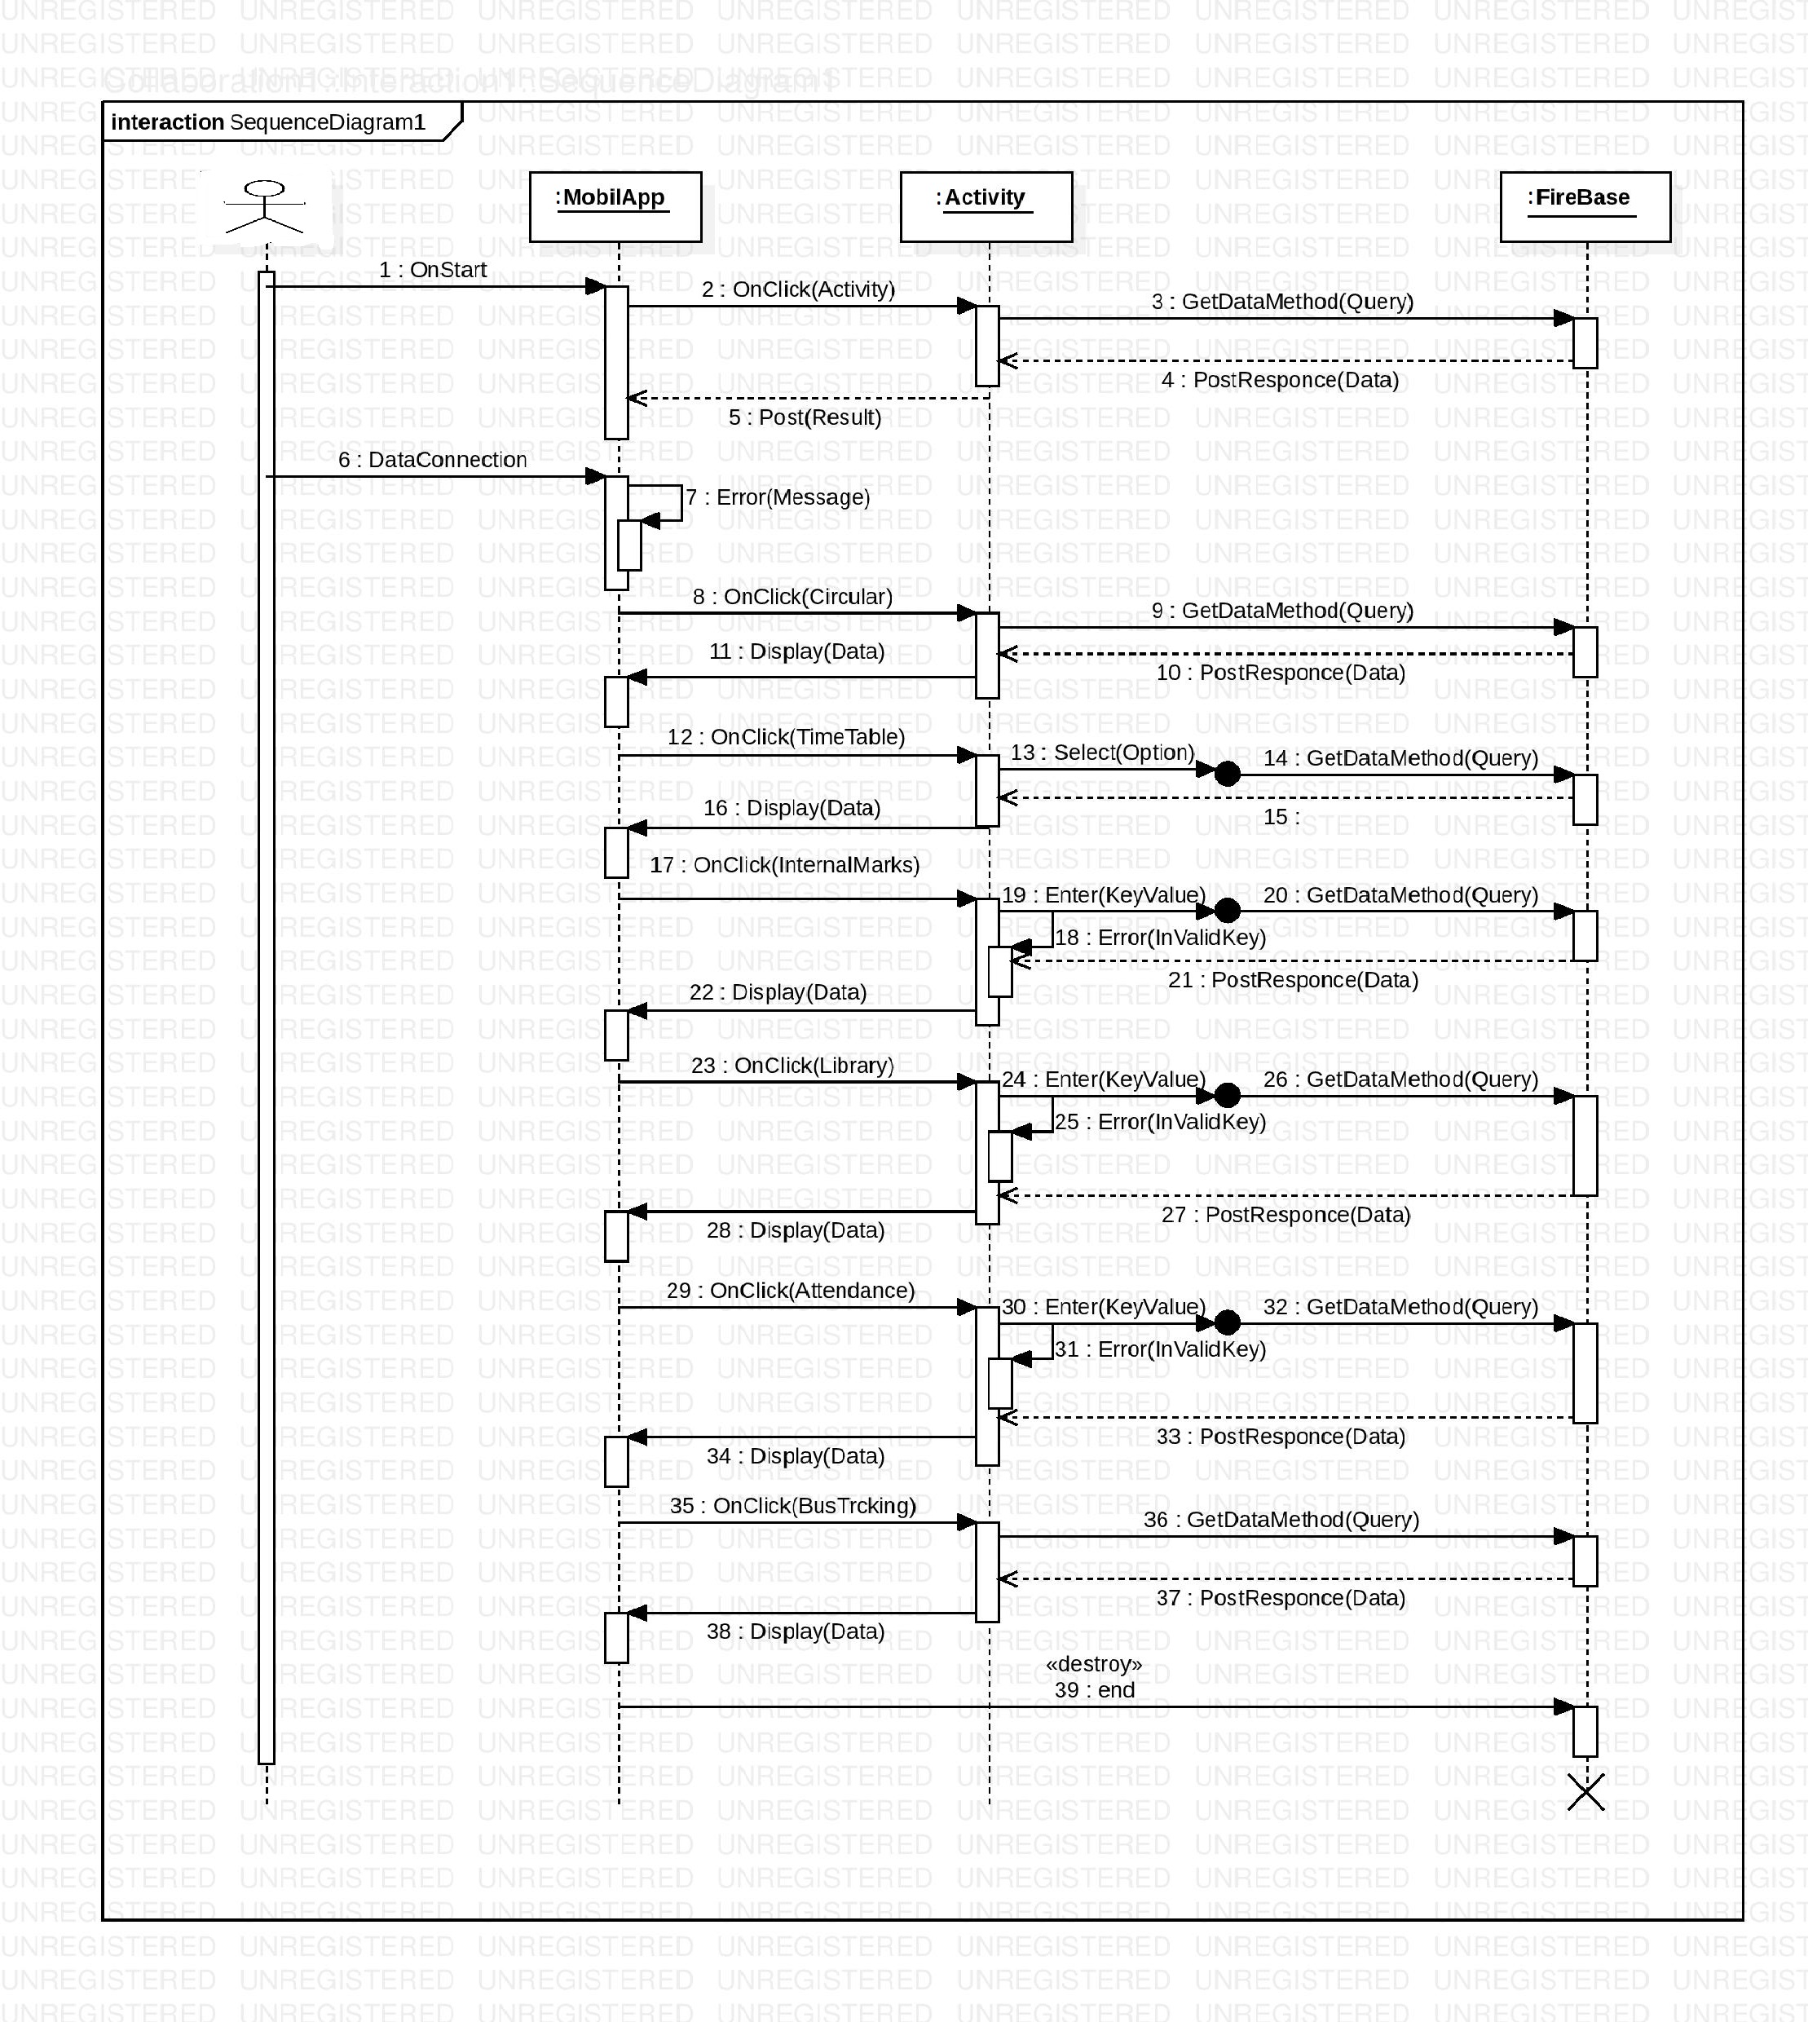
SEQUENCE DIAGRAM

Slide 20
DFD DIAGRAMS

Slide 21
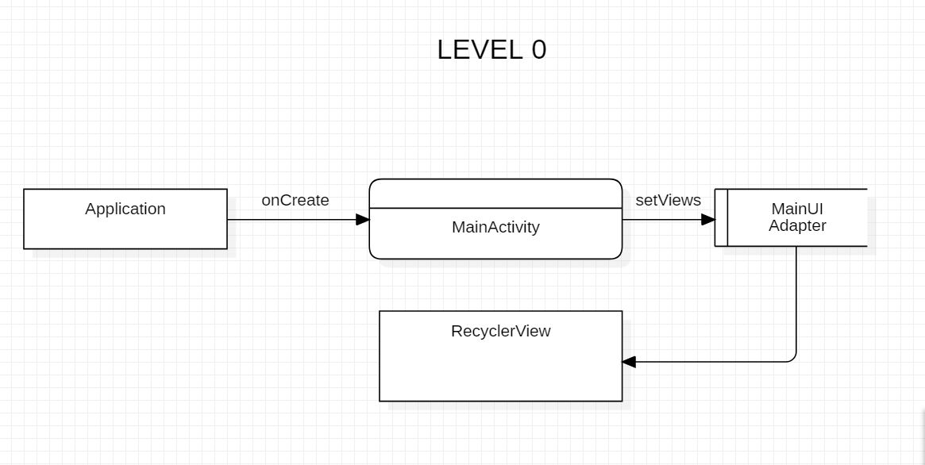
Level 0

Slide 22
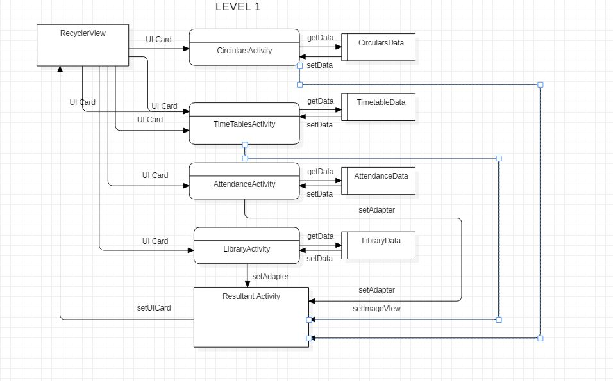
Level 1

Slide 23
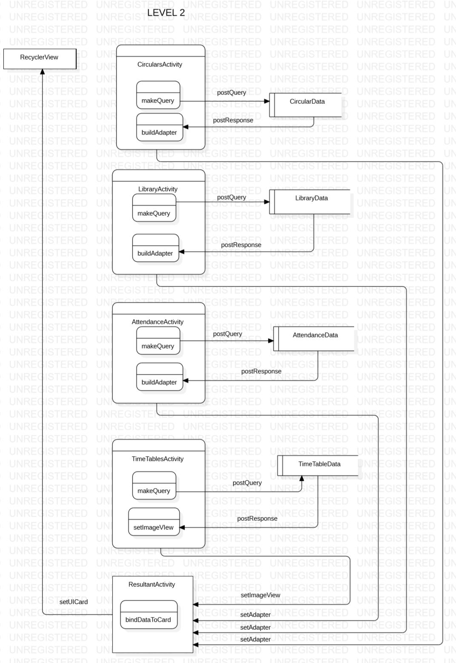
Level 2

Slide 24
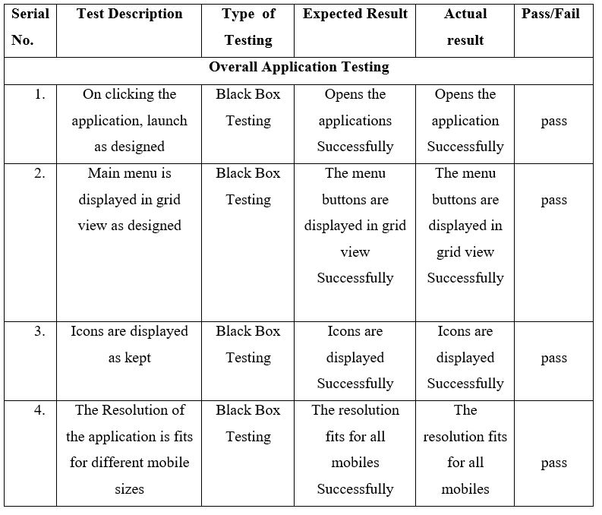
Test cases

Slide 25
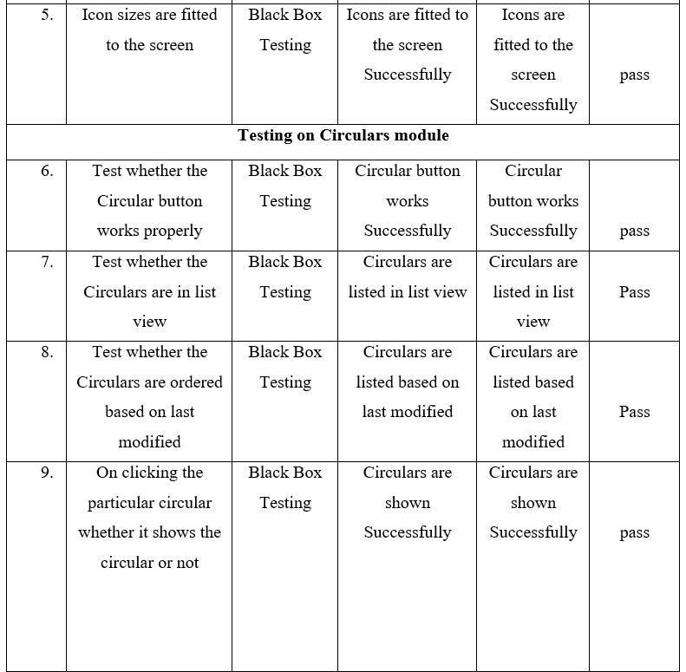

Slide 26
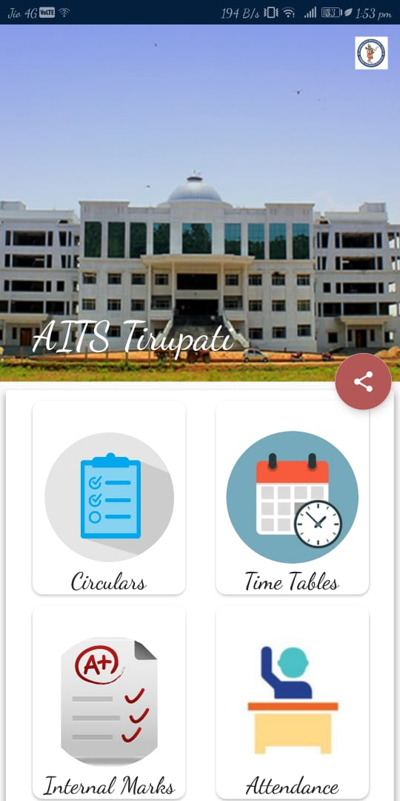
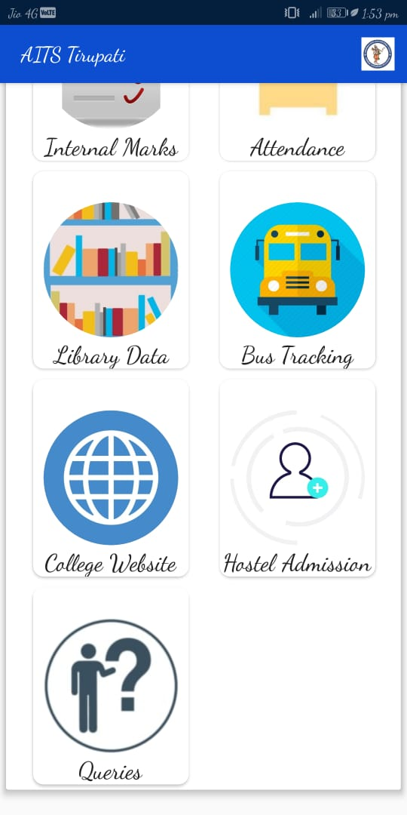
User Output Screens Home Screen

Slide 27
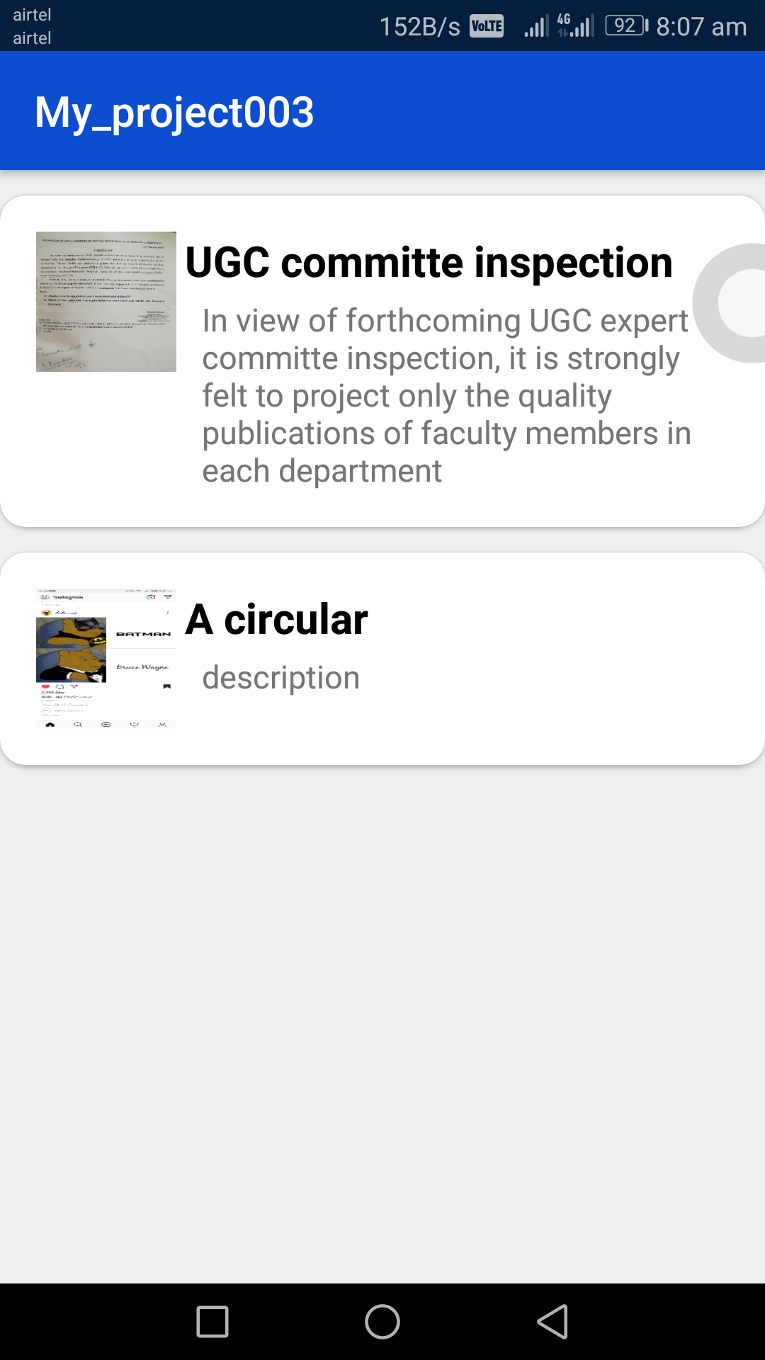
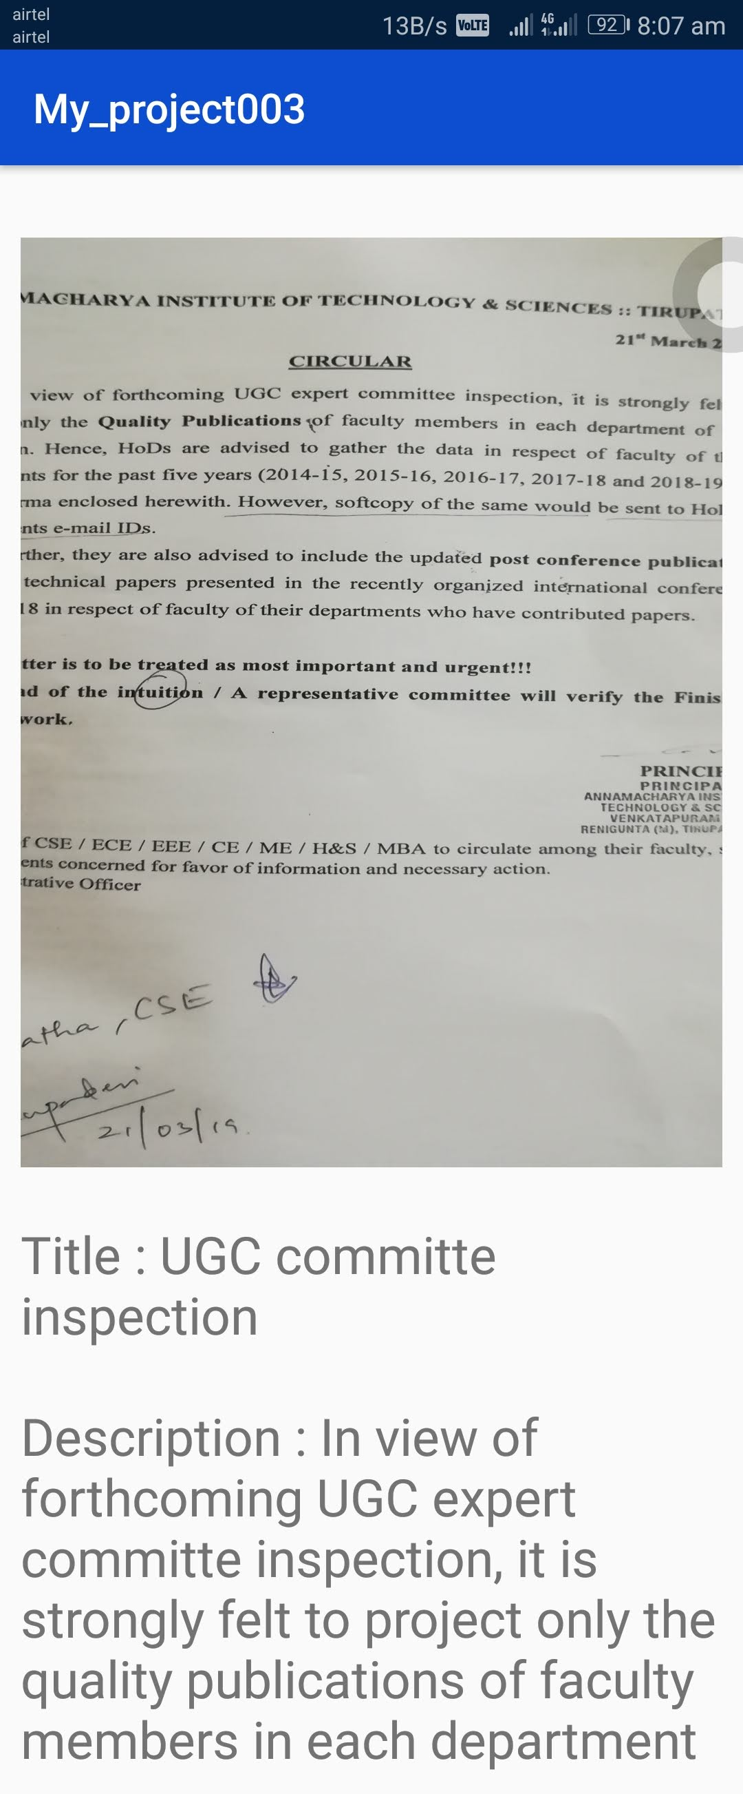
CIRCULAR SCREEN

Slide 28
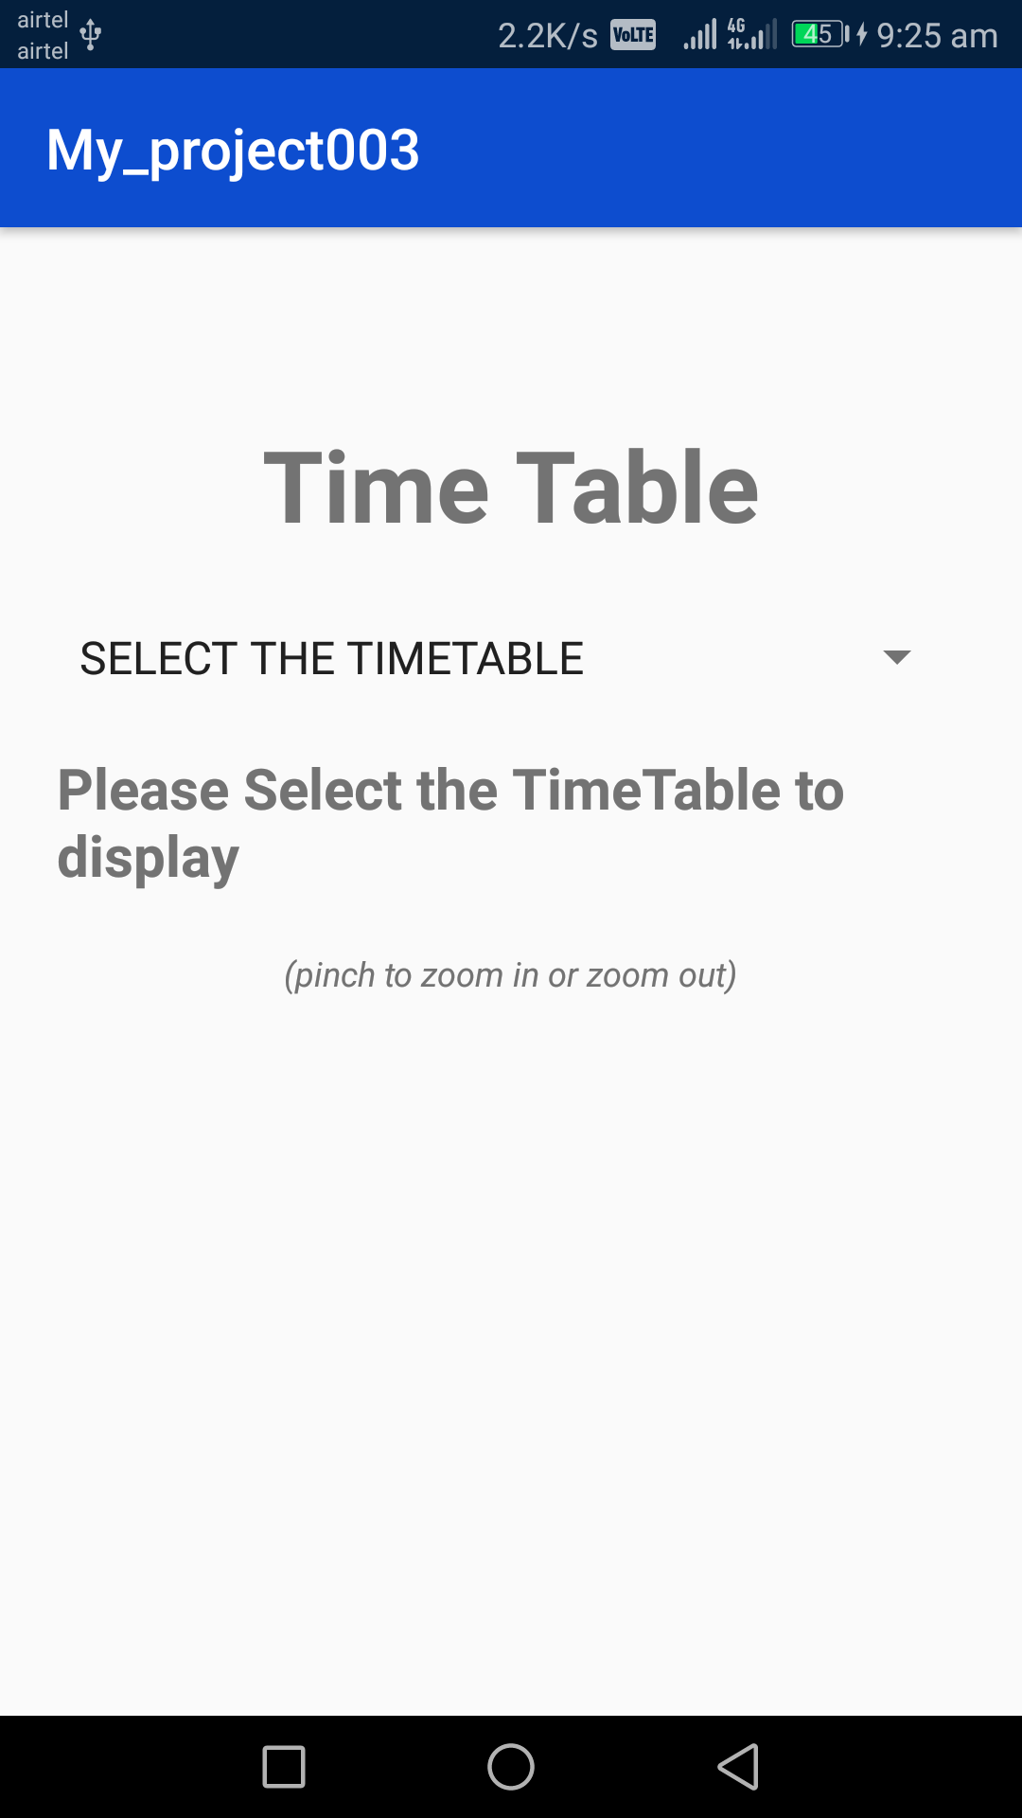
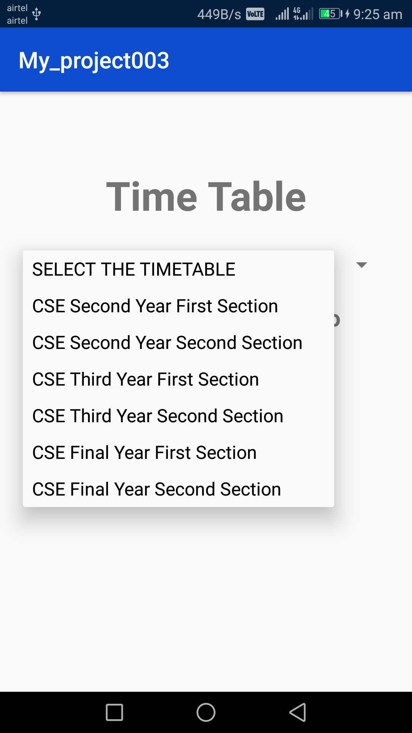
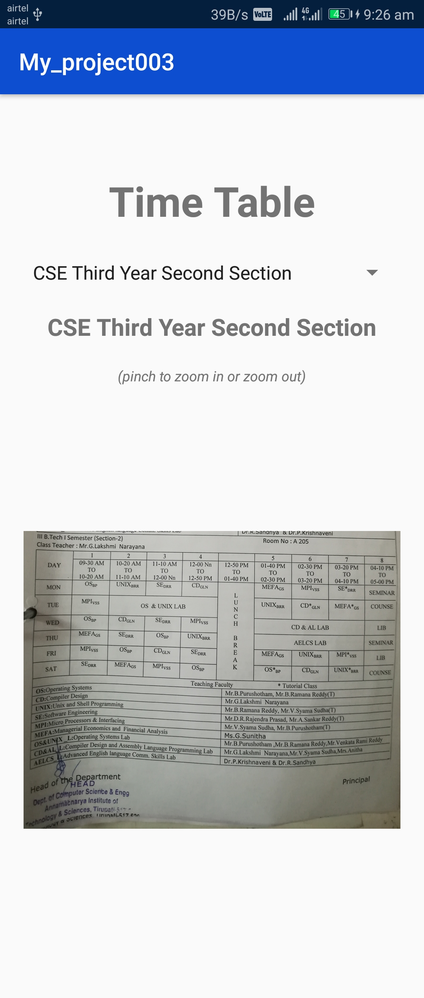
Time Tables Screen

Slide 29
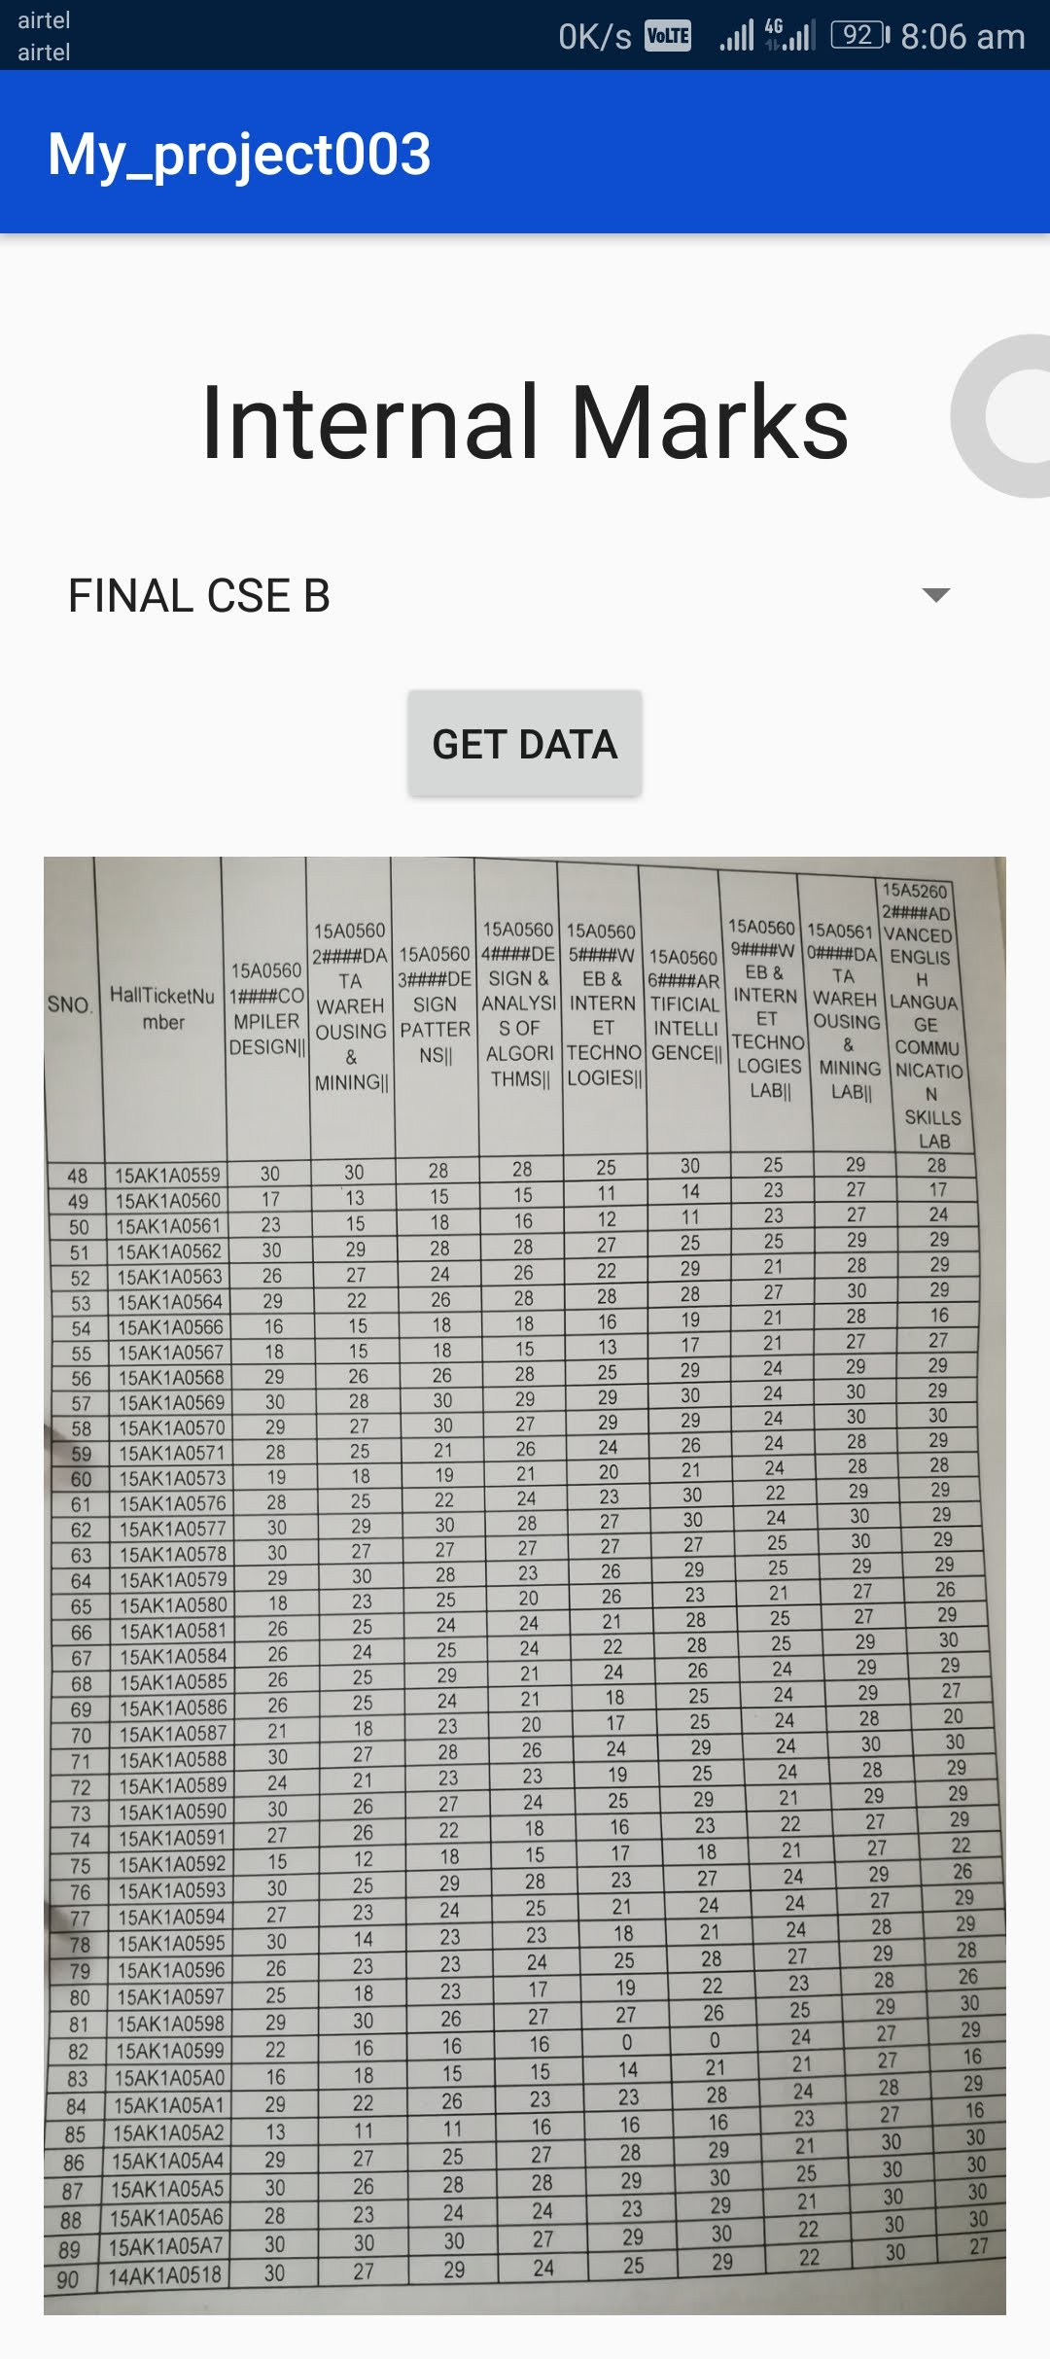
INTERNAL MARKS

Slide 30
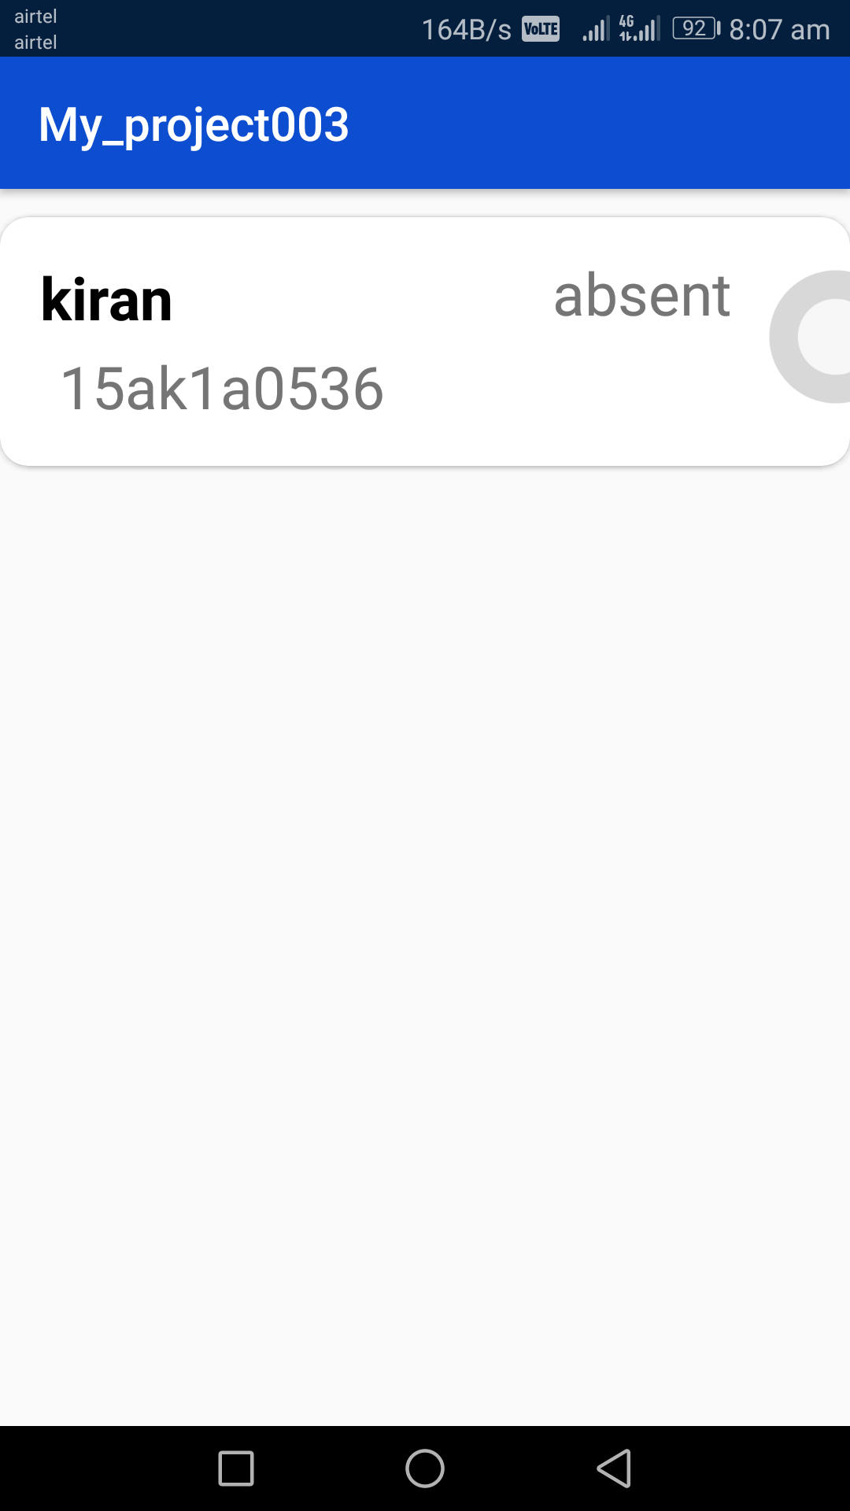
ATTENDANCE

Slide 31
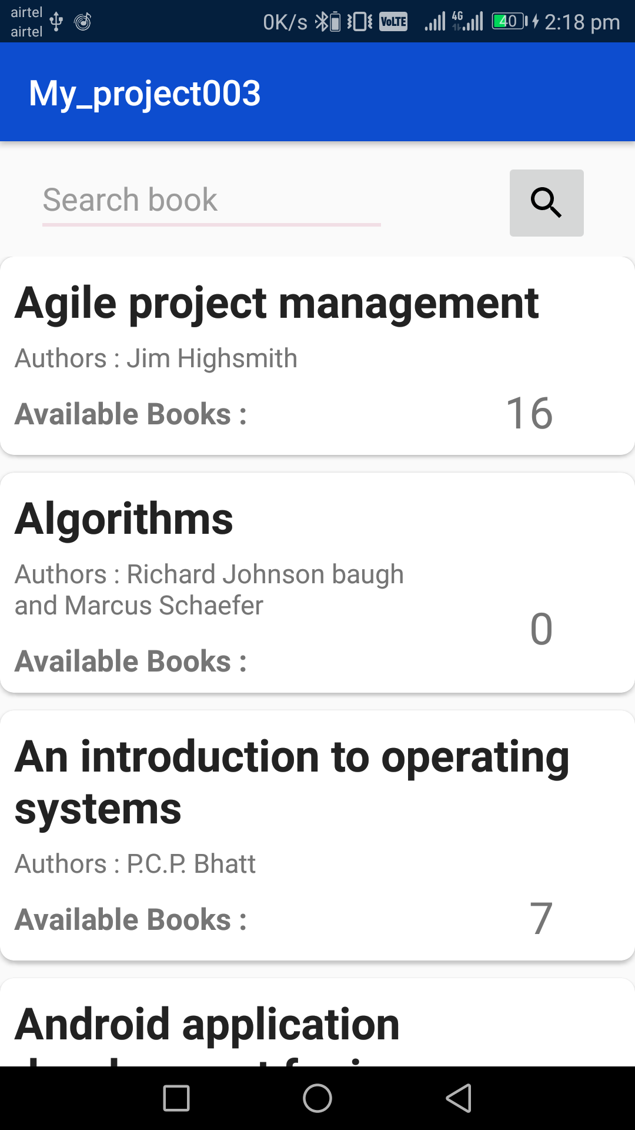
LIBRARY DATA

Slide 32
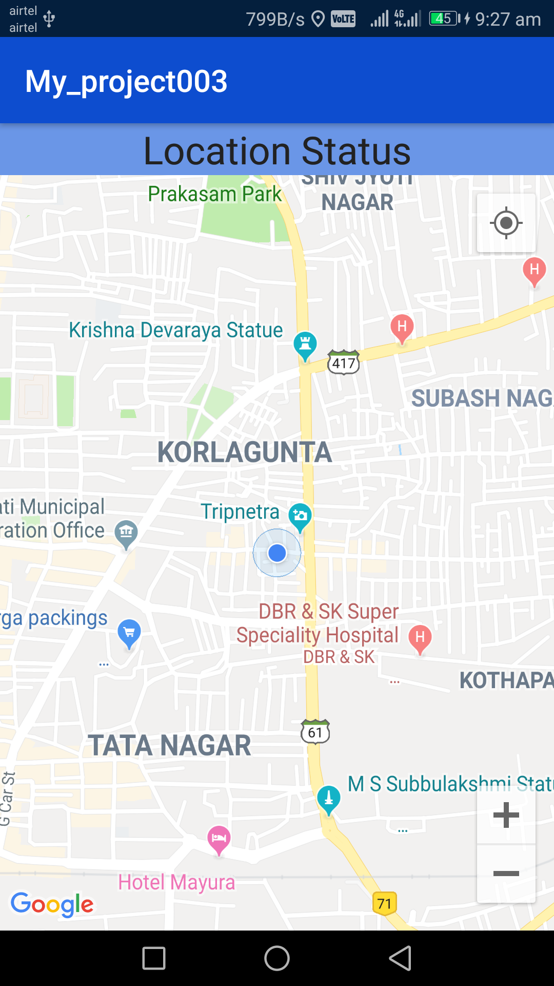
BUS TRACKING

Slide 33
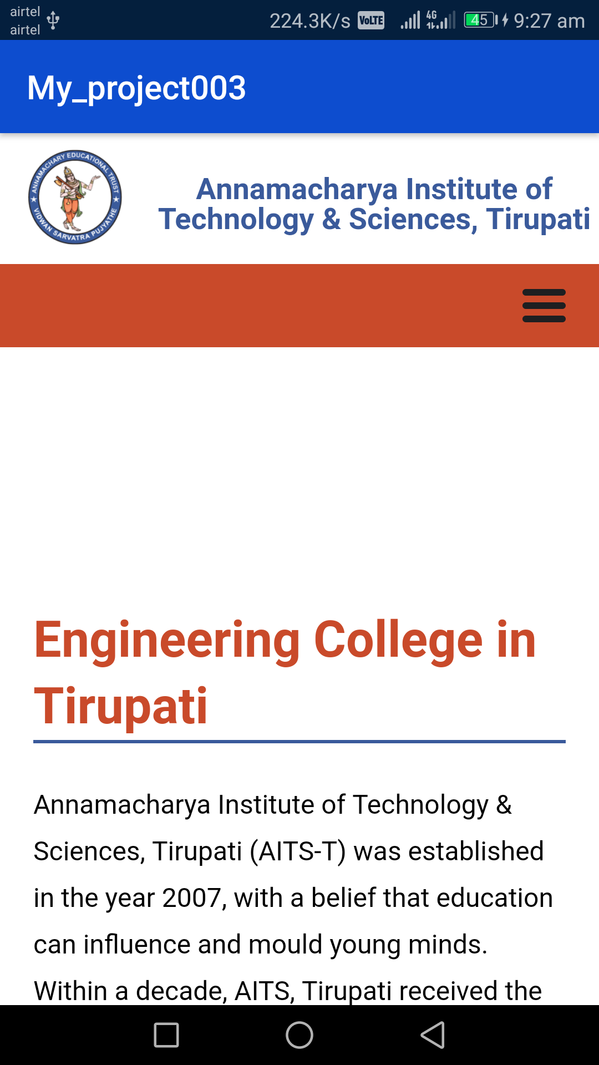
COLLEGE WEBSITE SCREEN

Slide 34
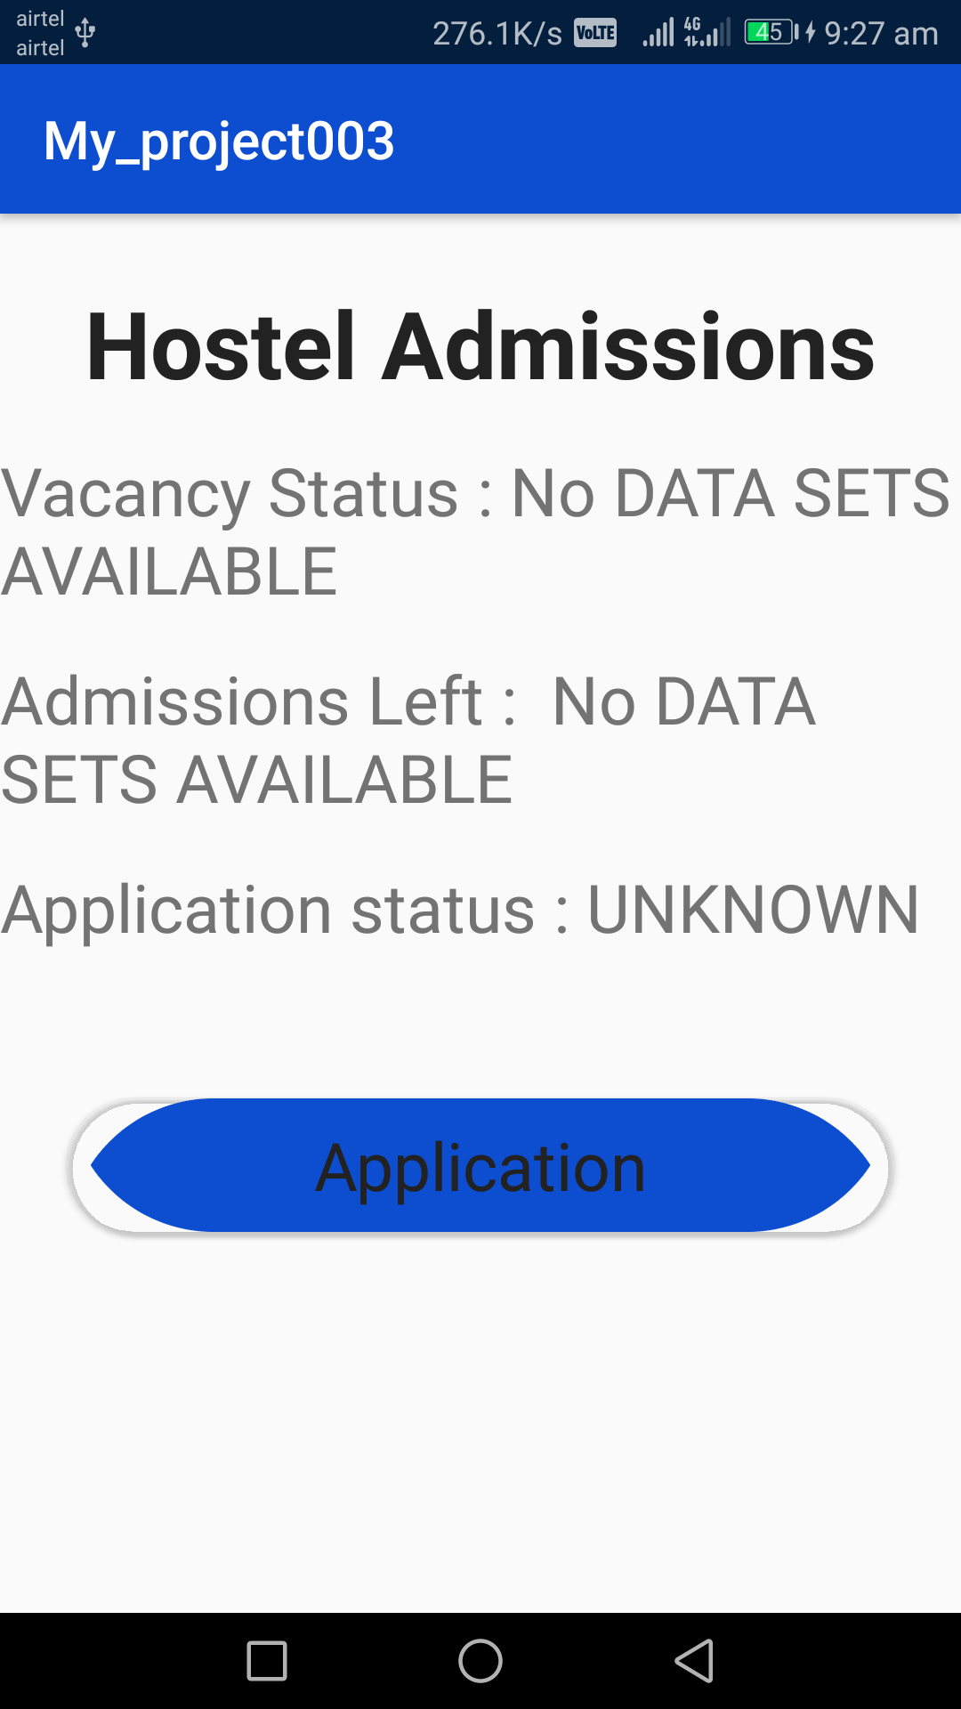
HOSTEL MANAGEMENT

Slide 35
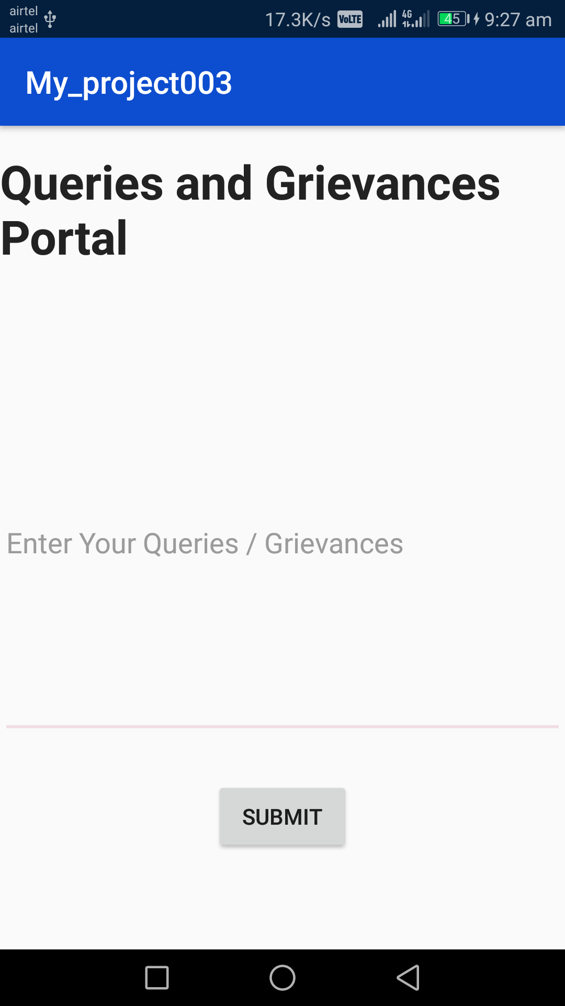
QUERIES

Slide 36
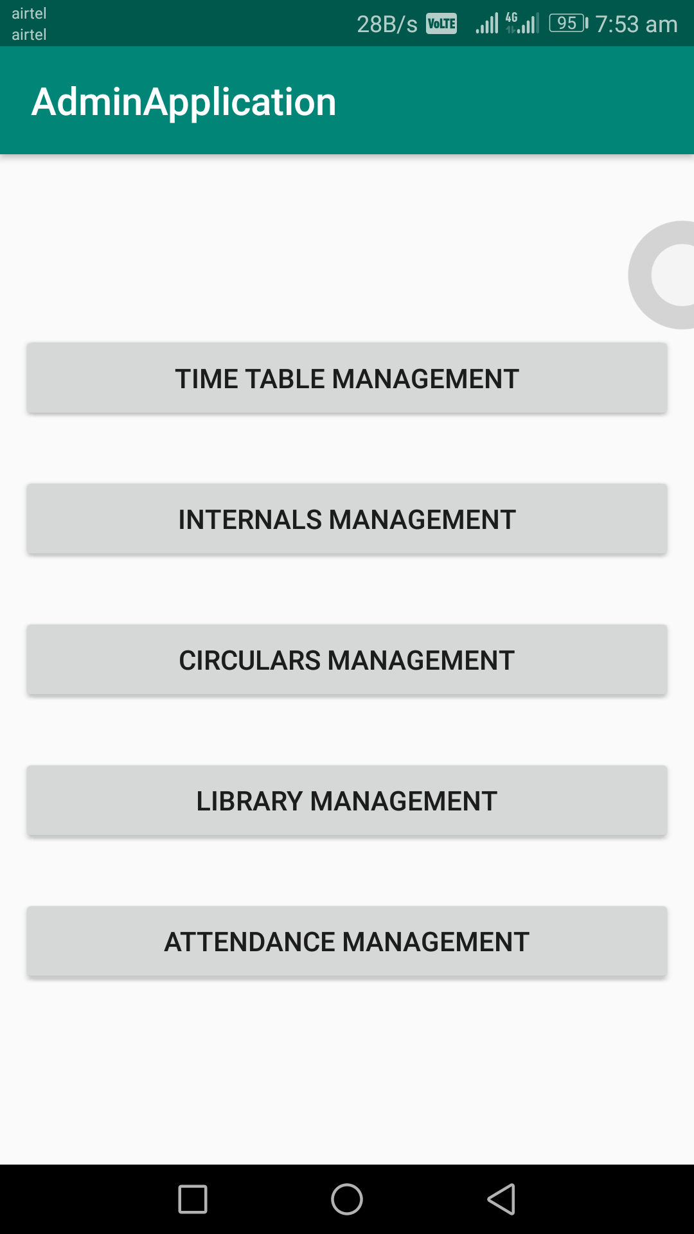
Admin Output Screens Home Screen

Slide 37
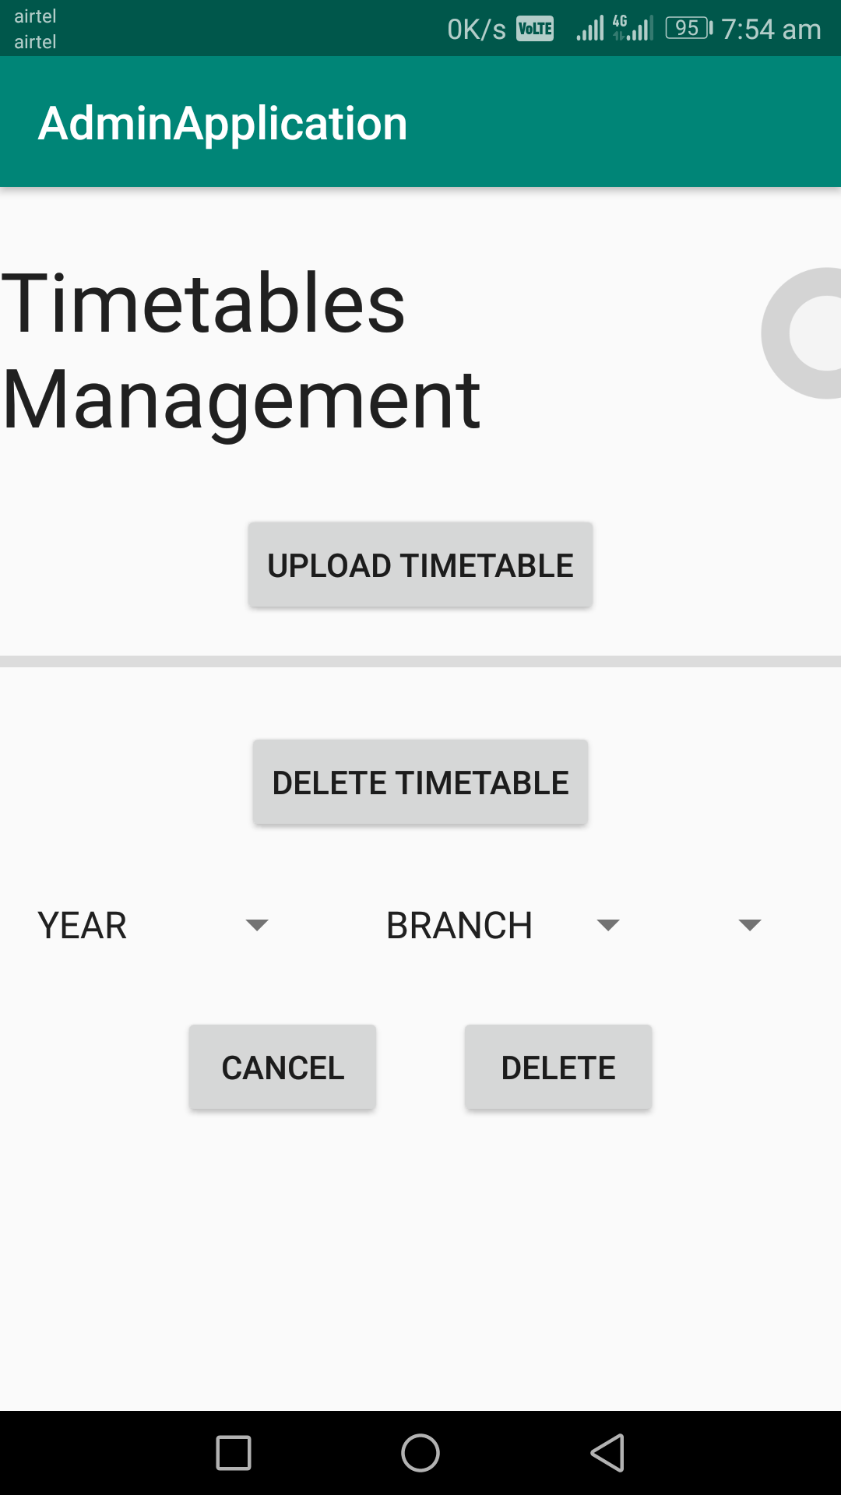
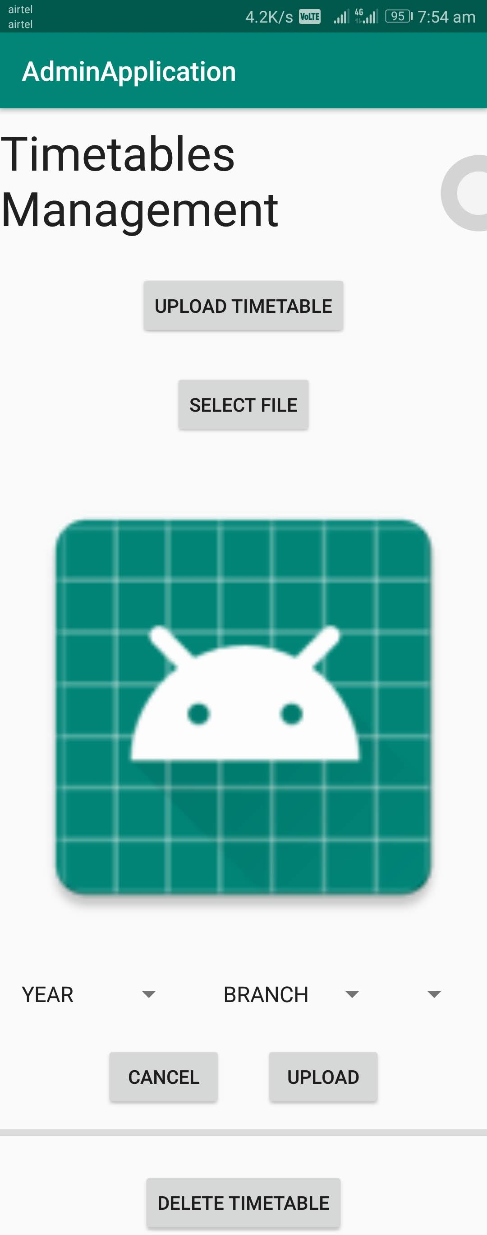
Time Table Management

Slide 38
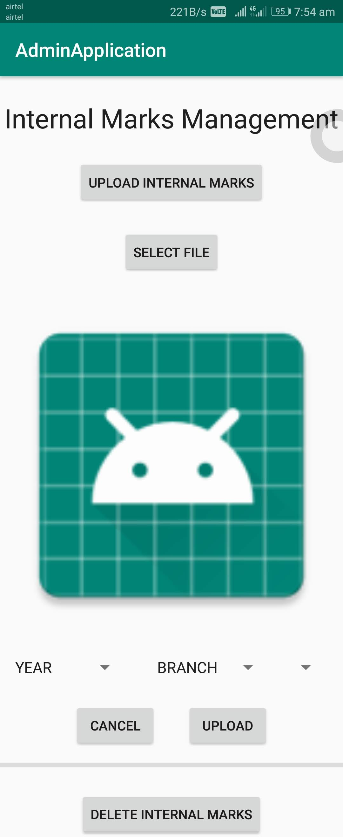
Internal marks screen

Slide 39
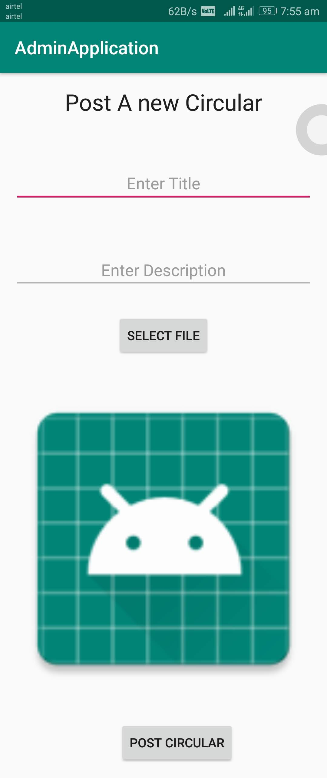
Circulars Screen

Slide 40
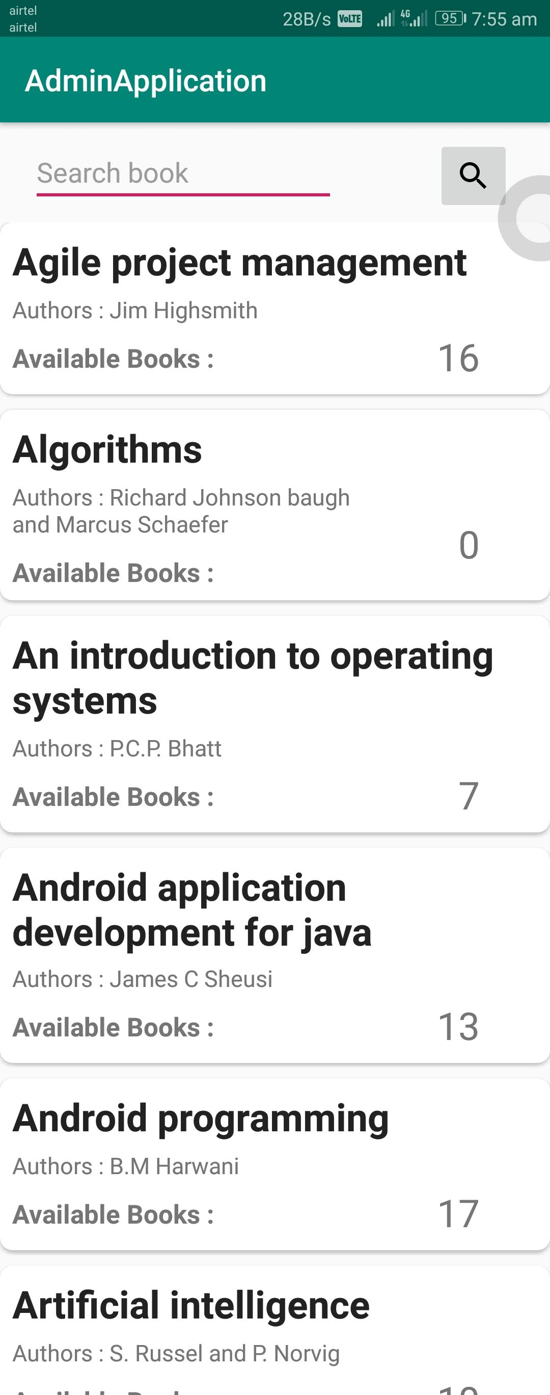
Library Data Screen

Slide 41
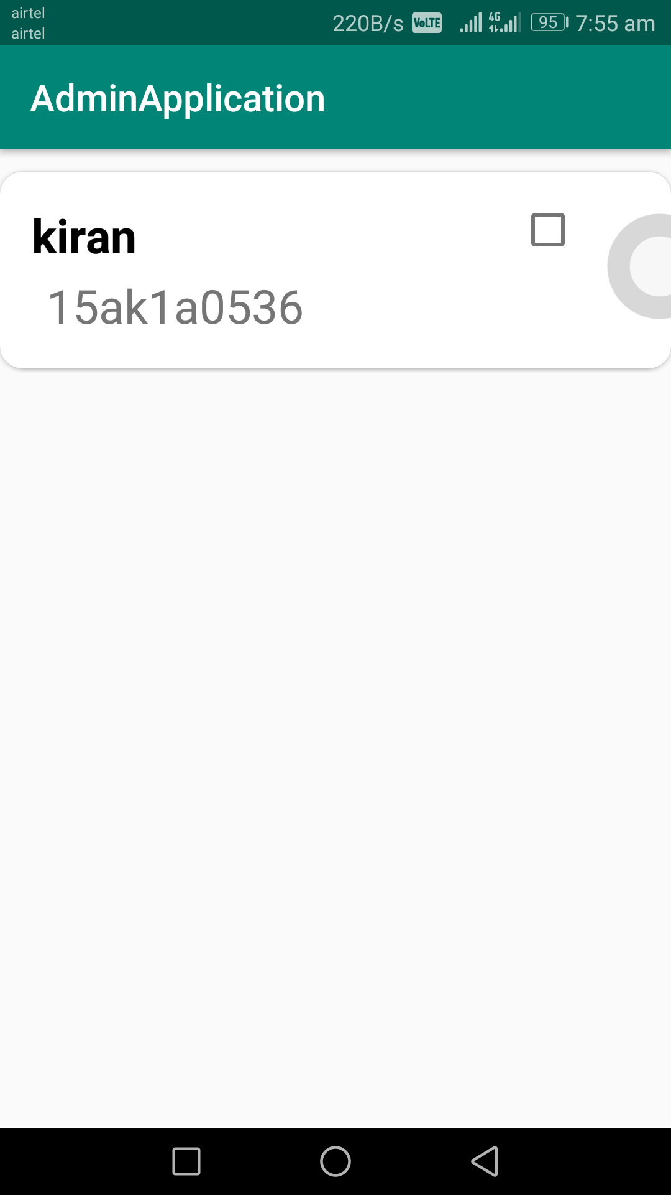
Attendance Screen

Slide 42
conclusion
OUR PROJECT INTEGRATES MOST OF THE PROBLEMS THAT ARE FACING BOTH THE FACULTIES AND STUDENTS.
IN THIS PROJECT WE INTRODUCE LIVE BUS TRACKING AND HOSTEL REGISTRATION. THE AVAILABILITY OF THIS OPTIONS WOULD BE MORE HELPFUL TO THE STUDENTS.
THIS IS ONE APPLICATION FOR ALMOST ALL PURPOSES.

Slide 43
FUTURE ENHANCEMENT
There is a scope in the future that social networking can also be added where students can communicate with each other.
Also online class functionality can be added and online exam functionality can be added.
Online fee payment like College fee, Examination fee, any fine payments can also be added.

Slide 44
REFERENCES
https://developer.android.com/docs
https://firebase.google.com/docs
https://github.com/googlesamples/android-CardView/#readme
https://github.com/googlesamples/android-RecyclerView/#readme
https://developer.android.com/studio/write/sample-code
https://developer.android.com/training/basics/firstapp
https://developer.android.com/guide

Slide 45
THANK YOU

